Slide 1



Bubbles
COMSATS UNIVERSITY ISLAMABAD
LAHORE CAMPUS
FA22CS11
Bubbles
AI Powered Communication Assistant
Group Members
Supervisor:
Muhammad Ahmed & Attique Rehman Alias Adeel
Dr. Jawad Shafi

Slide 2
Content.
1.0
Introduction
& Importance
5.0
Implementation
2.0
Core Features
6.0
Results
& Analysis
3.0
System Architecture
7.0
Future
Work
4.0
Hybrid
RAG
8.0
Conclusion

Slide 3
Bubbles
Introduction & Importance
Section 1.0
Page 1.0
1.0
Introduction
& Importance
Group Members
Supervisor:
Muhammad Ahmed & Attique Rehman Alias Adeel
Dr. Jawad Shafi

Slide 4
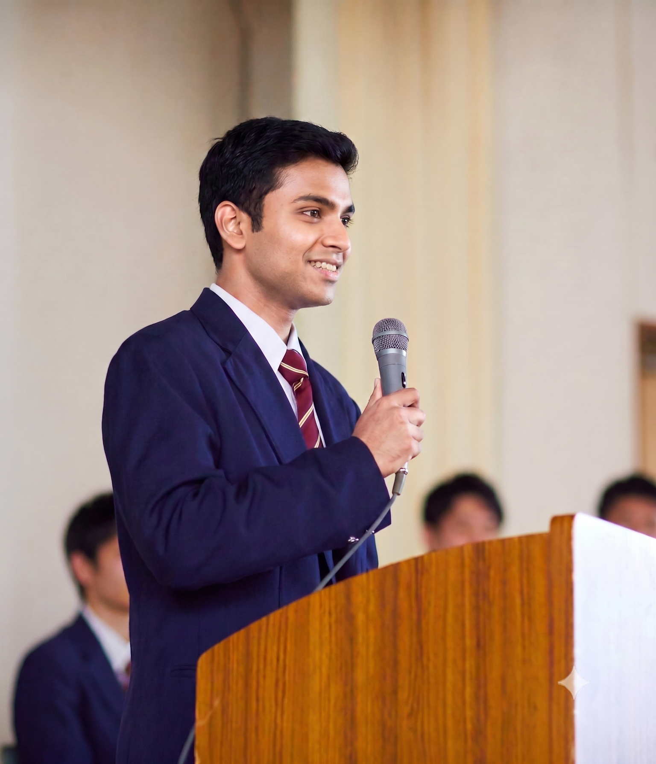
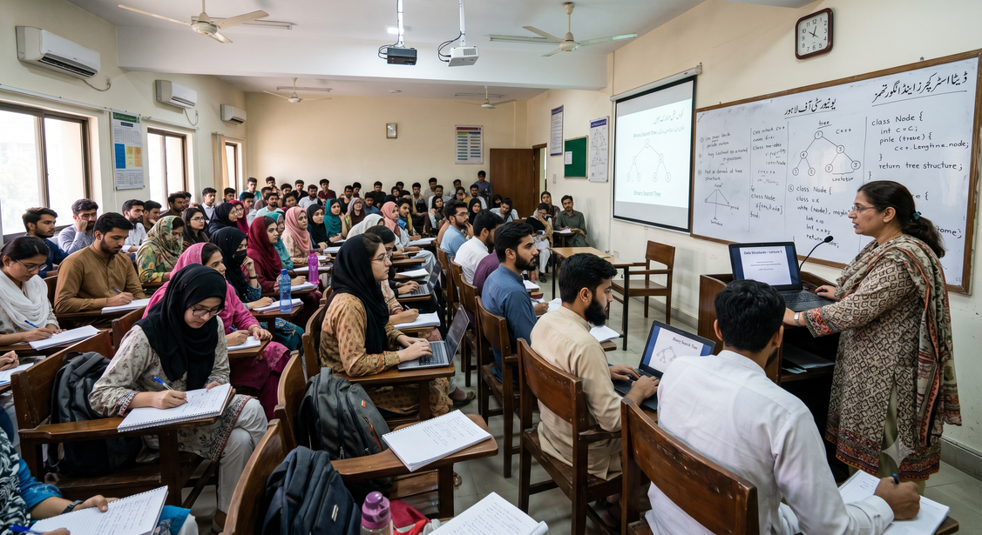

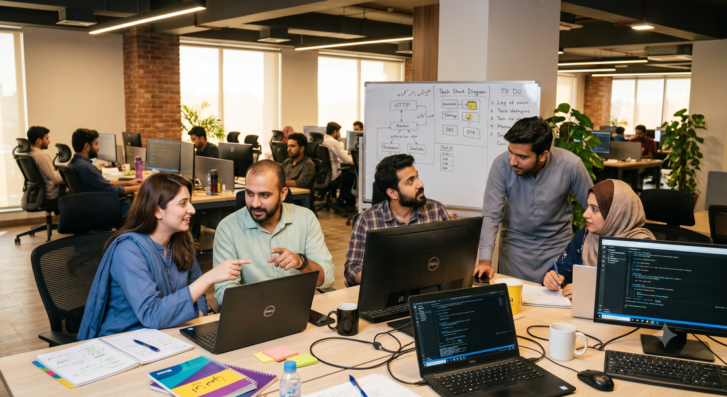
Bubbles
Introduction & Importance
Importance
Page 1.1
Communication
Skills Importance
Good communication serves as the foundational cornerstone for professional success, academic achievement, and everyday social interactions. In our fast-paced world, the ability to articulate concepts clearly, understand subtleties in tone, and retain vital information from spoken conversations is essential for achieving your goals
Academic
Achievement
Core Foundation
Social Interaction
Professional Success

Slide 5
Bubbles
Introduction & Importance
Decline
Page 1.2
Decline in
Communication skills
01
Missed Key Details
02
Agenda
Drift
03
Post-Conversation Regret
04
Lack of Real-Time Feedback
05
Misaligned Key Concepts
06
Inappropriate Tone Usage

Slide 6
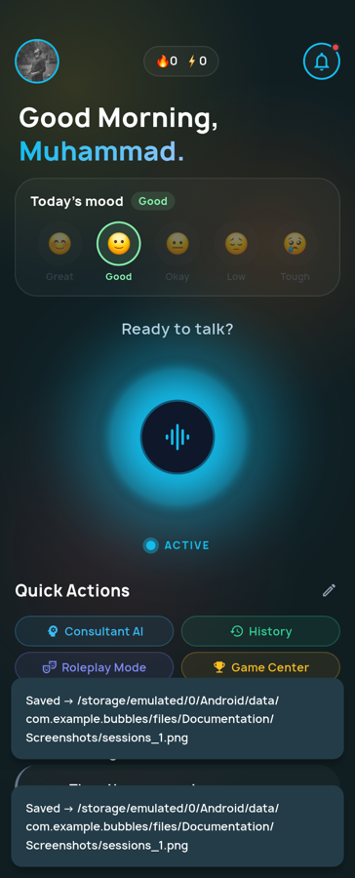






Bubbles
Introduction & Importance
Solution
Page 1.3
Proposed
Solution

Slide 7
Bubbles
Introduction & Importance
Objectives
Page 1.4
01
Live Coaching
03
Gamified Growth
Provides instant, in-session feedback on tone, clarity, and phrasing to help users identify and correct communication errors while they are actively speaking
Motivates users to consistently improve their communication habits through an engaging progress dashboard featuring XP, levels, streaks, and quests
02
Contextual Q&A:
04
Roleplay Practice
Employs a Knowledge Graph and vector memory to allow users to accurately search and ask questions about people, topics, and details from past conversations
Enables users to select and converse with specific entities (such as people) extracted from past sessions, allowing them to rehearse real-life scenarios and practice conversations
Core
05
Insights Dashboard
Objectives
Displays events, key facts, and action items extracted automatically from conversations, allowing users to quickly review important details later and ask questions about each entity without having to read through full transcripts.

Slide 8
Content.
1.0
Introduction
& Importance
5.0
Implementation
2.0
Core Features
6.0
Results
& Analysis
3.0
System Architecture
7.0
Future
Work
4.0
Hybrid
RAG
8.0
Conclusion

Slide 9
Bubbles
Main Features
Section 2.0
Page 2.0
2.0
Main Features
Group Members
Supervisor:
Muhammad Ahmed & Attique Rehman Alias Adeel
Dr. Jawad Shafi

Slide 10
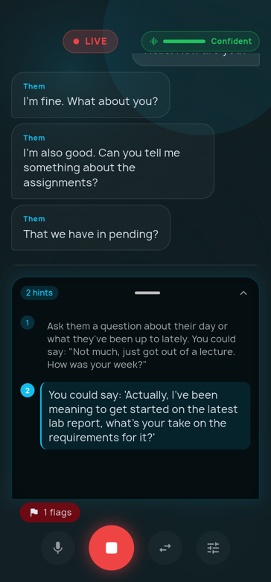
Bubbles
Main Features
Wingman
Page 2.1
Live audio transcription
Instantly converts spoken words into text during conversations
Active speaker diarization
Identifies and distinguishes between different speakers in real time
Instant coaching suggestions
Provides immediate, actionable communication advice while you speak
Analyzes conversation tone
Evaluates the emotional undertone of the ongoing dialogue
Live
Wingman

Slide 11
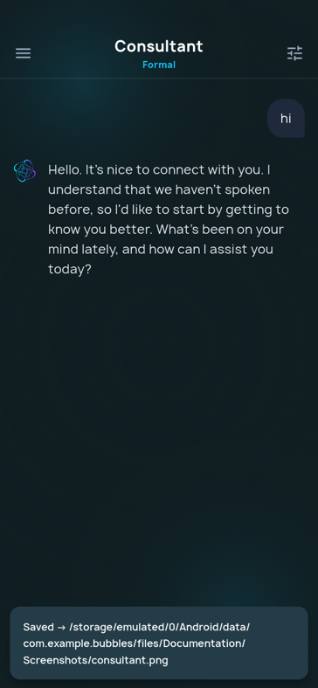
Bubbles
Main Features
Consultant
Page 2.2
Consultant
Mode
Context-aware Q&A
Gives grounded answers based on knowledge of your past sessions
Queries past conversations
Searches through past dialogue data to retrieve relevant details
Hybrid RAG retrieval
Merges vector similarity & graph search for accurate answers
Text or voice input
Interact and ask questions by either typing or speaking

Slide 12
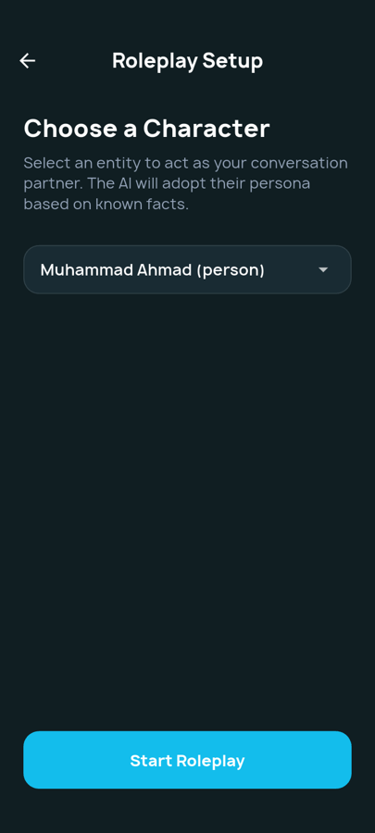
Bubbles
Main Features
Roleplay
Page 2.3
Roleplay
System
Select graph entities
Choose a person or persona from knowledge graph to interact with
Injects relational context
Fetch historical relationship data to make simulated conversation realistic
Practice past personas
Rehearse conversations with individuals you've previously encountered
Rehearse realistic scenarios
Simulates true-to-life interactions to help you prepare for actual meetings

Slide 13
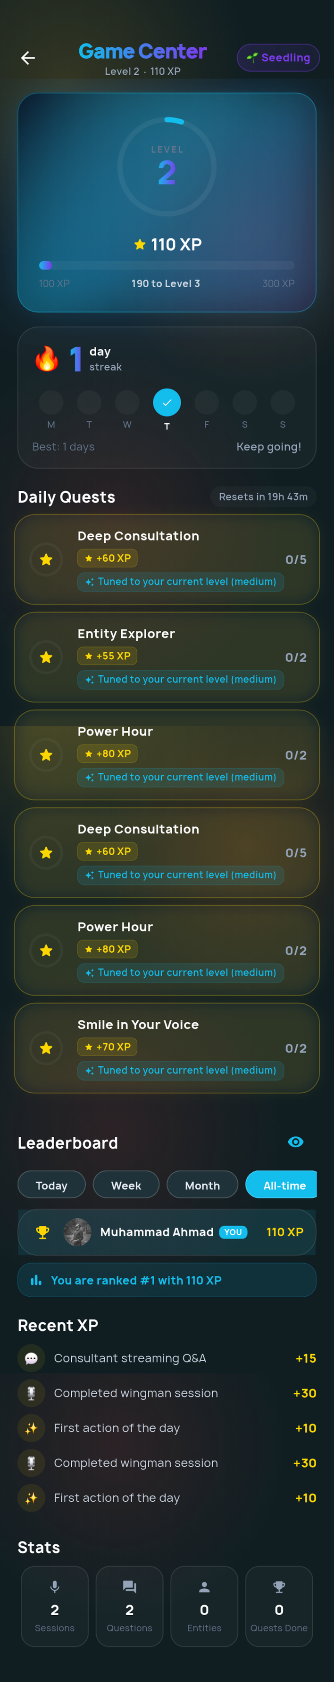
Bubbles
Main Features
Gamification
Page 2.4
Earn XP and levels
Rewards experience points to level up based on application usage
Complete daily customized quests
Offers personalized daily challenges to encourage users
Track daily activity streaks
Monitors consecutive days of usage to help you build a habit
Compete on user leaderboards
Ranks progress against other users to motivate friendly competition
Gamification
Engine

Slide 14
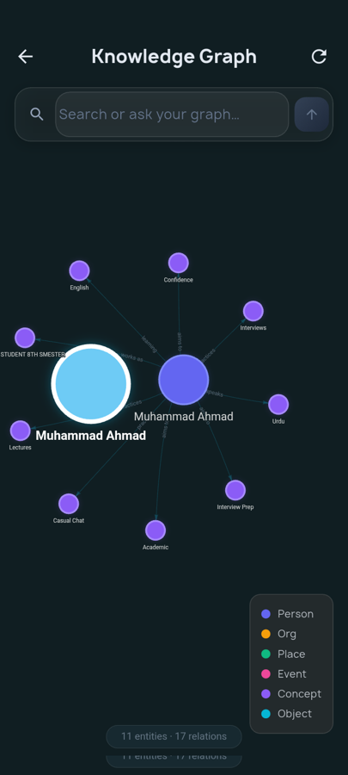
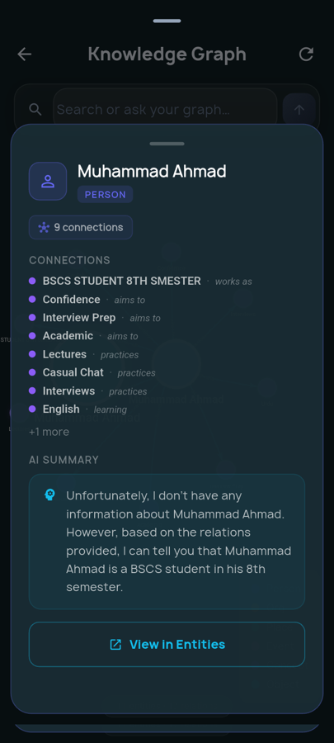
Bubbles
Main Features
Knowledge Graph
Page 2.5
Knowledge
Graph
Explorer

Slide 15
Bubbles
Main Features
Knowledge Graph
Page 2.6
Knowledge
Graph
Explorer
Interactive visual entity graph
Displays connections between people and topics in a dynamic visual web
Tap for AI summaries
Generates instant AI overviews of an entity when you select its node
Color-coded node types
Differentiates entity categories (like people or places) using distinct colors
Explore connections
Allows intuitive navigation of relationships between different data points

Slide 16
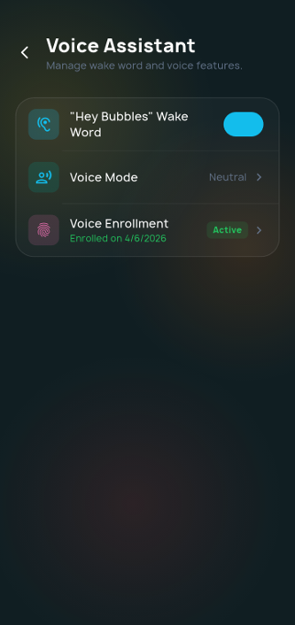
Bubbles
Main Features
Vpoce Controls
Page 2.7
Voice
Controls
Hands-free app control
Enables navigation and use of application entirely via voice commands
Custom wake word activation
Uses the "Hey Bubbles" phrase to trigger the assistant seamlessly
Background listening mode
Continuously listens for wake word without needing to tap screen
LLM intent routing
Directs spoken commands to correct feature using LLM

Slide 17
Content.
1.0
Introduction
& Importance
5.0
Implementation
2.0
Core Features
6.0
Results
& Analysis
3.0
System Architecture
7.0
Future
Work
4.0
Hybrid
RAG
8.0
Conclusion

Slide 18
Bubbles
System Architecture
Section 3.0
Page 3.0
3.0
System Architecture
Group Members
Supervisor:
Muhammad Ahmed & Attique Rehman Alias Adeel
Dr. Jawad Shafi

Slide 19
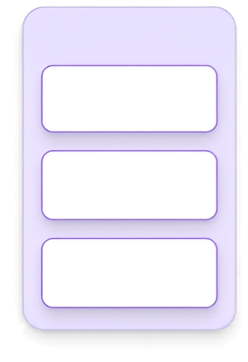


































Bubbles
System Architecture
High level Diagram
Page 3.1
CLIENT
PROCESSING ENGINE
AI MODELS
DATA LAYER
Llama 3
(8B + 70B)
Supabase + PostgreSQL
Flutter App
FastAPI Server
Voice Capture
Live Transcription
Groq Whisper
pgvector
Store
Inference
WebSocket Stream
Coaching Logic
SpeechBrain
Knowledge Graph
Stream
Speaker ID (ECAPA-TDN)
Redis
Cache
Data Storage

Slide 20

Bubbles
System Architecture
Data flow
Page 3.2
Data Flow:
From Audio to Insight
Audio
Ingestion
LLM
Extraction
Speaker
Diarization
Transcription
Persistence

Slide 21

Bubbles
System Architecture
ASR Model
Page 3.3
ASR Model:
Groq Whisper
Utilizes the whisper-large-v3-turbo
Uses Groq's high-speed Whisper model for accurate speech recognition
Low latency in text transcription
Converts speech to text with minimal delay to ensure real-time performance
Generates accurate timestamps
Precisely records the exact moment each word is spoken
Handles Voice Activity Detection
Automatically distinguishes between active speech and background silence

Slide 22
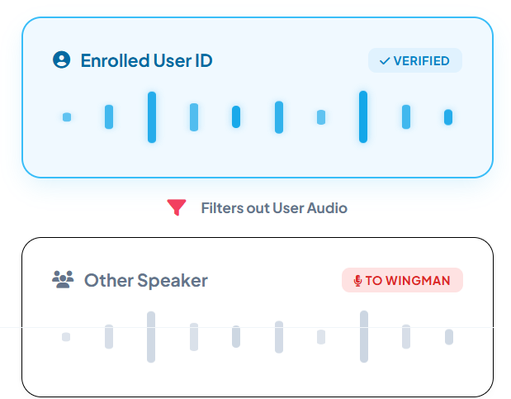
Bubbles
System Architecture
Diarization Model
Page 3.4
Diarization Model
SpeechBrain ECAPA
Utilizes speechbrain/spkrec-ecapa-voxceleb model (ECAPA-TDNN)
Employs ECAPA-TDNN neural network specialized for voice recognition
Tracking the enrolled user versus other
Differentiates your specific voice from other participants in the room
The model is lightweight and loads lazily
Designed for efficiency without consuming excessive resources

Slide 23
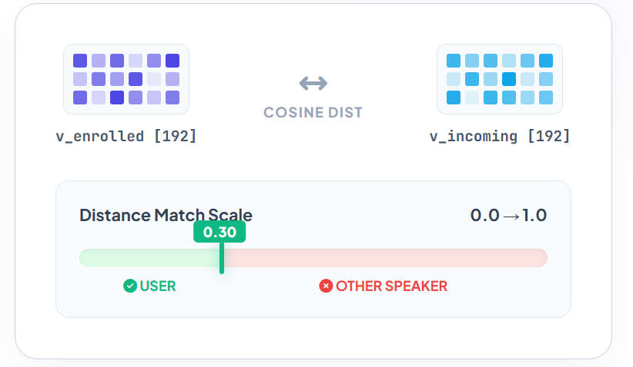
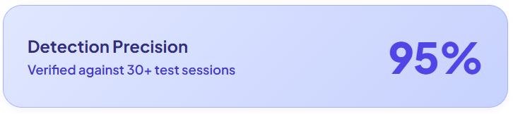
Bubbles
System Architecture
Diarization Model
Page 3.5
Diarization Logic
Vector Matching
Converts the user's enrolled voice sample to192-dimensional embedding
Transforms your voiceprint into a dense mathematical vector
Audio chunks are matched against voice print using pgvector's cosine distance
Transforms your voiceprint into a dense mathematical vector

Slide 24
Bubbles
System Architecture
Embedding Model
Page 3.6
Embedding Model:
all-MiniLM
Uses the all-MiniLM-L6-v2
Employs efficient transformer model for creating text embeddings
Converts text into 384-dimensional vectors
Transforms transcriptions into mathematical formats for semantic searchability
Operates locally on CPU resources
Runs directly on standard processors without requiring a dedicated GPU
Handles Voice Activity Detection
Assists in processing audio activity directly alongside the embeddings pipeline

Slide 25
Bubbles
System Architecture
LLM Routing
Page 3.7
LLM Routing:
Fast vs. Deep Inference
Fast Tier Execution using Llama 3.1 8B
Uses a lightweight model for instant, low-latency Wingman advice
Deep Tier Reasoning using Llama 3.3 70B
Uses a complex, heavy model for in-depth Consultant Q&A
Reliability multi-provider Architecture
Implements fallback mechanisms across providers to ensure zero downtime

Slide 26
Bubbles
System Architecture
Database Architecture
Page 3.8
Database:
Architecture
Session Logs
Vector Memory
Graph Storage
Purpose
Purpose
Purpose
Turn-by-turn conversational record.
Long-term semantic memory store.
Relational mapping and factual context.
Fields
Fields
Fields
Speaker identity, diarization labels, transcript confidence, inline sentiment scores.
384-dim pgvector for cosine similarity search, importance weights, confidence tags.
Canonical names (nodes), relationship strength (edges), specific factual details.

Slide 27
Content.
1.0
Introduction
& Importance
5.0
Implementation
2.0
Core Features
6.0
Results
& Analysis
3.0
System Architecture
7.0
Future
Work
4.0
8.0
Hybrid RAG
Conclusion

Slide 28
Bubbles
Hybrid RAG
Section 4.0
Page 4.0
4.0
Hybrid RAG
Group Members
Supervisor:
Muhammad Ahmed & Attique Rehman Alias Adeel
Dr. Jawad Shafi

Slide 29
Bubbles
Hybrid RAG
RAG
Page 4.1
What is:
RAG
User Query
Retreival
Augmentation
Generation
Natural language
question
Cosine similarity
search (pgVector)
Context + Query
Natural Language
Answer

Slide 30
Bubbles
Hybrid RAG
Vector search
Page 4.2
Hybrid RAG:
Vector Search
Saved in
Transformed
into
Vector
Embeddings
PostgreSQL
(pgVector)
Session
Transcript
Similar
chunks
Found
Searched in
Transformed
into
Vector
Embeddings
cosine simiilarity (0.65)
Query

Slide 31
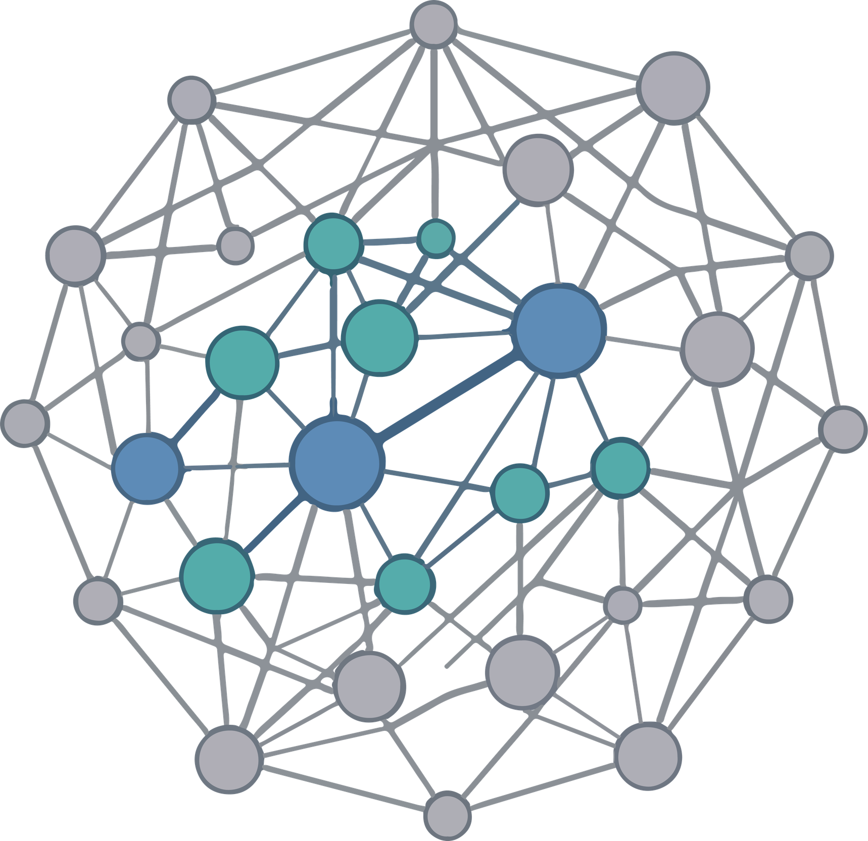
Bubbles
Hybrid RAG
Graph Traversal
Page 4.3
Hybrid RAG:
Graph Traversal
Clustering
Extraction
Nodes
& Edgess
Session
Transcript
PostgreSQL
(NetworkX)
Context Fusion
Nodes search
Transformed
into
Graph hopes
Query
Fuzzy & Heuristic
matching wordss

Slide 32
Bubbles
Hybrid RAG
Hybrid RAG
Page 4.4
Hybrid RAG:
Fusing Data
Combined
Context
Vector Search
LLM
Query
PostgreSQL
(pgVector)
Similar chunks
Graph Traveersal
Contextual
Answer
PostgreSQL
(NetworkX)
Context Fusion

Slide 33
Content.
1.0
Introduction
& Importance
5.0
Implementation
2.0
Core Features
6.0
Results
& Analysis
3.0
System Architecture
7.0
Future
Work
4.0
Hybrid
RAG
8.0
Conclusion

Slide 34
Bluseel
Hybrid RAG
Section 5.0
Page 5.0
5.0
Implementation
Group Members
Supervisor:
Muhammad Ahmed & Attique Rehman Alias Adeel
Dr. Jawad Shafi

Slide 35


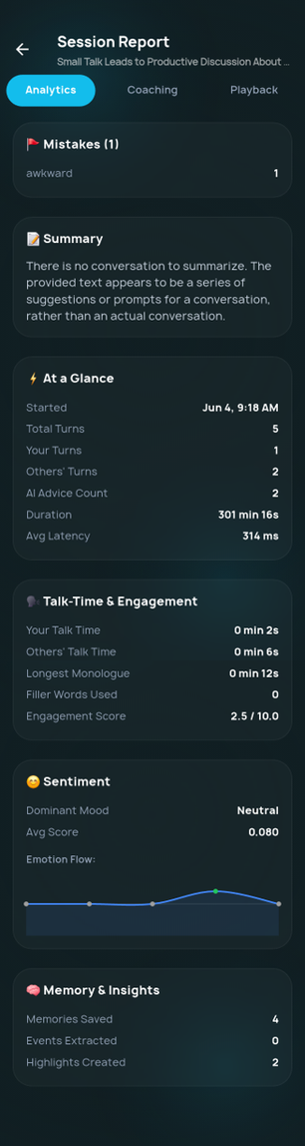
Bubbles
Implementation
Frontend
Page 5.1
Clean UI using Flutter 3.10
Utilizes the Flutter framework for a smooth, cross-platform mobile experience
Low-Latency Audio Pipeline
Maintains a direct, custom WebSocket connection to ensure real-time audio streaming and processing with minimal delay
Glassmorphic Visual Identity
Employs frosted glass effects and layered UI components to create a modern, visually engaging mobile experience
Implementation:
Frontend

Slide 36



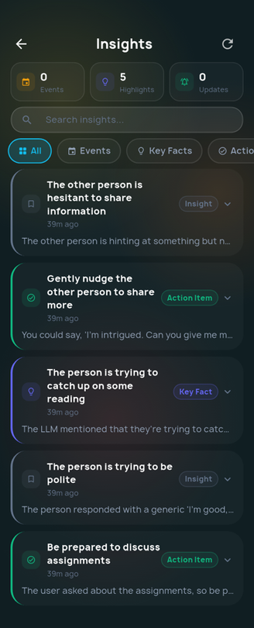

Bubbles
Implementation
Frontend (2)
Page 5.2
Implementation:
Frontend

Slide 37



Bubbles
Implementation
Backend
Page 5.3
Implementation:
Backend
FastAPI
Multi-LLM Routing
Task Queuing
Asynchronous high-performance framework handling concurrent WebSocket audio streams
Dynamic fallback logic between Cerebras (Low Latency) and Groq (Deep Reasoning)
14-worker ARQ queue on Redis for non-blocking extraction, sentiment, and summarization

Slide 38
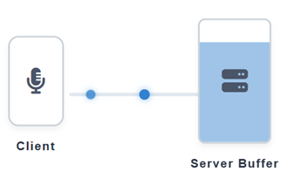
Bubbles
Implementation
Custom websocket
Page 5.4
Custom
websocket
Low-Latency Transport
Ensures audio data is sent to the server with minimal delay
High-Quality Capture sampled at 16,000Hz
Captures clear, professional-grade audio for accurate transcription
Adaptive Streaming
data transfer rates dynamically to maintain a stable connection
Scheduled Processing with 12 second flush
Processes audio in reliable chunks to maintain real-time conversational flow

Slide 39
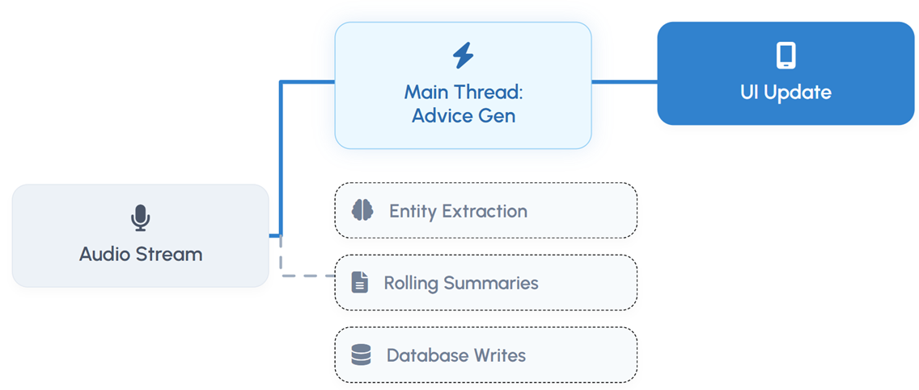
Bubbles
Implementation
Background Execution
Page 5.5
Parallel
Background Execution
Pipeline Rearchitecture
Splits operations into main and background
threads for maximum efficiency
Latency-Critical Path
Keeps urgent tasks like audio and UI on
main thread for fast feedback
Async Worker Offloading
Moves heavy processing and database writes
to the background to prevent lag

Slide 40
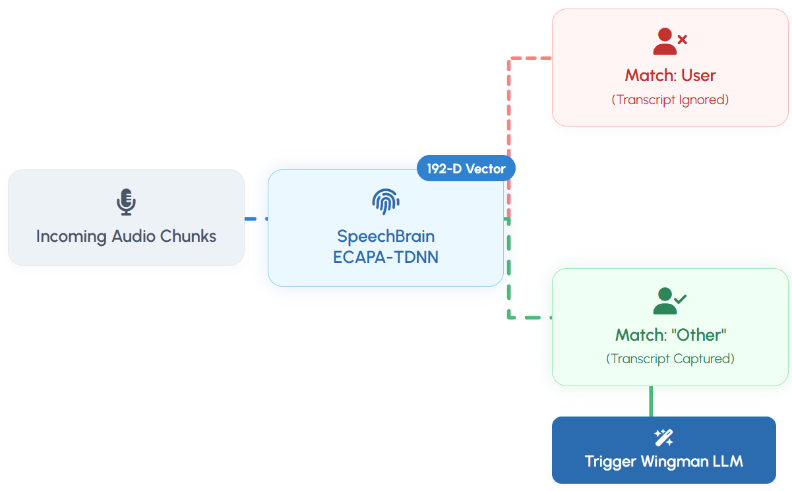
Bubbles
Implementation
Voiceprint Filtering
Page 5.6
Strict
Voiceprint Filtering
Diarization Architecture: SpeechBrain ECAPA-TDNN
Integrates SpeechBrain ECAPA-TDNN for highly accurate, real-time speaker separation
Vector Verification
Uses consine difference to confirm the speaker's identity confidently
Targeted Execution on other speaking
Ensures Wingman advice is triggered specifically by what the other person says

Slide 41
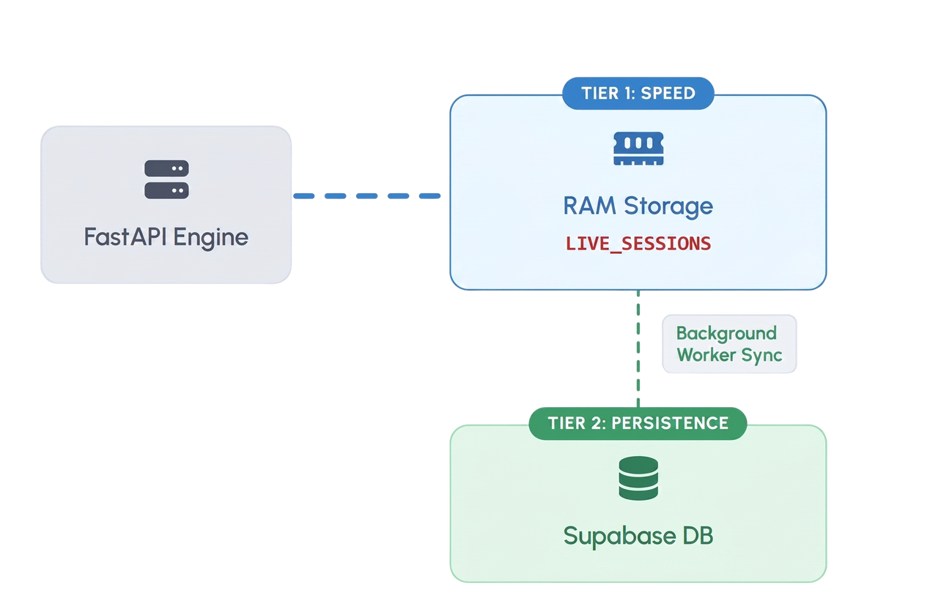
Bubbles
Implementation
Custom websocket
Page 5.7
Tiered
Session Management
Dual-Tiered Architecture
Splits data between a fast cache and permanent storage
In-Memory Speed
Uses high-speed RAM for instant data access during active chats
Reliable Persistence
Securely auto-saves completed sessions to prevent any data loss

Slide 42
Content.
1.0
Introduction
& Importance
5.0
Implementation
2.0
Core Features
6.0
Results
& Analysis
3.0
System Architecture
7.0
Future
Work
4.0
Hybrid
RAG
8.0
Conclusion

Slide 43
Bluseel
Results & Analysis
Section 6.0
Page 6.0
6.0
Results
& Analysis
Group Members
Supervisor:
Muhammad Ahmed & Attique Rehman Alias Adeel
Dr. Jawad Shafi

Slide 44
Bubbles
Results & Analysis
Testing setup
Page 6.1
Testing
setup
Backend: Laptop with Nividia 3060 mobile
Runs locally on a laptop powered by an Nvidia 3060 mobile GPU for fast, on-device AI processing
Stack: FastAPI, Docker, Redis, Supabase
Utilizes scalable, backend architecture featuring FastAPI, Docker, Redis, and Supabase
Dataset: 20+ Sessions, 3500+ Lines
Evaluated against test set of over 20 live conversational sessions and 3,500+ lines of dialogue
Scale: 700+ Knowledge Graph Entities
Successfully manages and queries complex relational data within a
Knowledge Graph of over 700 distinct entities

Slide 45
Bubbles
Results & Analysis
ASR Accuracy
Page 6.2
ASR
Accuracy (Groq Whisper)
Quiet Room :: 92%
92%
Moderate Noise :: 85%
85%
3+ Speakers :: 88%
88%
Outdoor (Wind/Traffic) :: 80%
80%

Slide 46
Bubbles
Results & Analysis
ASR Accuracy
Page 6.3
Identity
Aware Diarization
94%
50ms
3%
Speaker Identification
Voiceprint Computation
False Positive Rate

Slide 47

Bubbles
Results & Analysis
Hybrid RAG Performance
Page 6.4
Hybrid
RAG Retrieval Performance
Hybrid (Vector Serach + KG): 95%
95%
Vector Search Only: 72%
Graph Only: 68%
Scale: 700+ Knowledge Graph Entities

Slide 48



Bubbles
Results & Analysis
Summary
Page 6.5
Summary
of System Execution
Multi Modal
Parallelized
Context Aware
5 SOTA models orchestrated for specialized tasks:
Llama 3.1 3b/70b, Groq Wshiper, all-MiniLM and Picovoice.
Context building moved to async background threads to zero-out latency.
384-dim embeddings paired with relational graph neighborhood traversal.

Slide 49
Bubbles
Results & Analysis
Competitive Analysis
Page 6.6
Competitive
Analysis
Feature
Otter.ai
Yoodli
Google Assistant
Bubbles (Ours)
Real-time coaching
No
⚠ Partial
No
✓ Yes (Wingman)
Identity Diarization
Speaker 0/1
Single speaker
N/A
✓ Voiceprint
Cross-session memory
Per-meeting
Metrics only
⚠ Partial
✓ KG + Vector
Gamification
No
No
No
✓ XP, Levels, Quests
✓ Open-source, User-controlled
Privacy Model
Enterprise harvesting
Cloud processing
Google ecosystem

Slide 50
Content.
1.0
Introduction
& Importance
5.0
Implementation
2.0
Core Features
6.0
Results
& Analysis
3.0
System Architecture
7.0
Future
Work
4.0
Hybrid
RAG
8.0
Conclusion

Slide 51
Bluseel
Future Work
Section 7.0
Page 7.0
7.0
Future
Work
Group Members
Supervisor:
Muhammad Ahmed & Attique Rehman Alias Adeel
Dr. Jawad Shafi

Slide 52
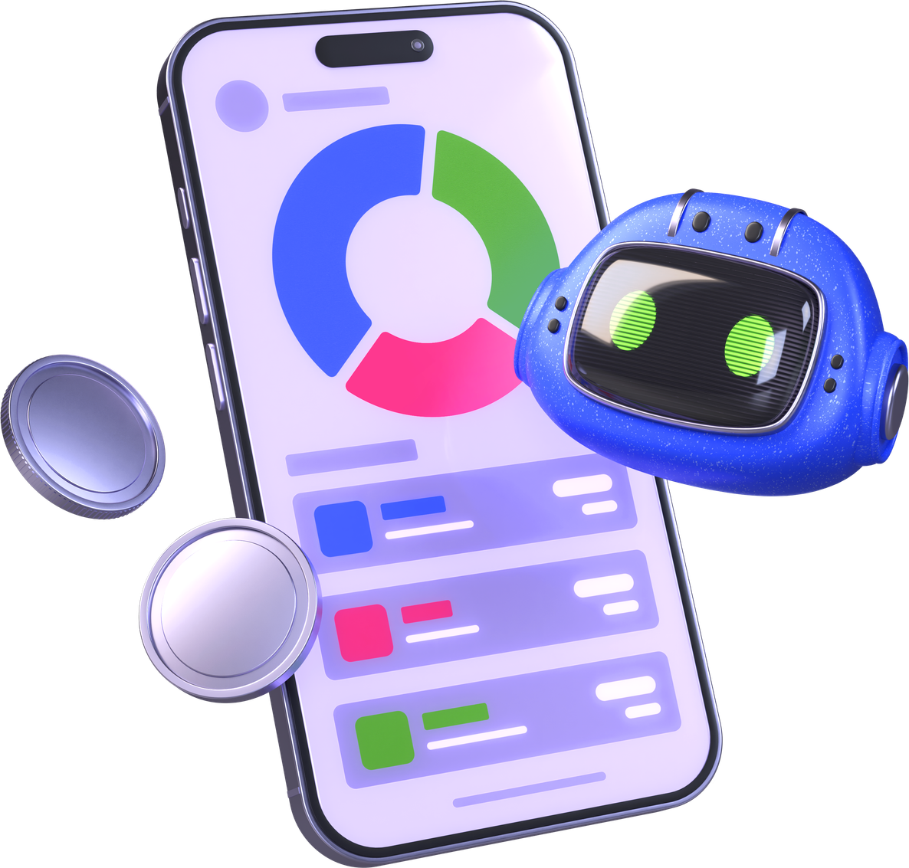
Bubbles
Future Work
Edge Computing
Page 7.1
Edge
Computing
Edge Processing
Shifting computational tasks directly to the mobile device instead of cloud
Offline Functionality
Allowing app to provide coaching without an active internet connection
Noise Filtering
Enhancing on-device audio cleanup before it reaches the AI models

Slide 53
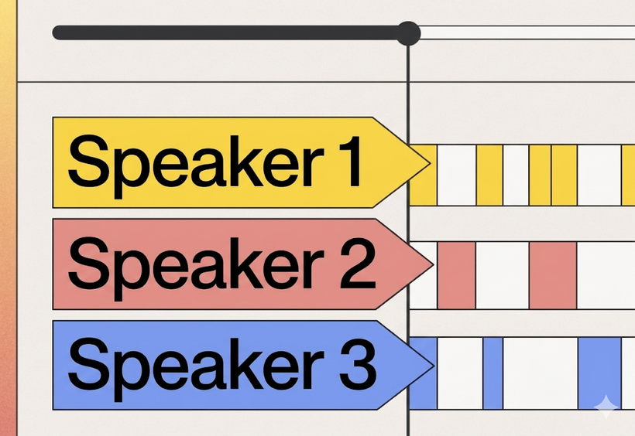
Bubbles
Future Work
Multi-Speaker Diarization
Page 7.2
Multi-Speaker
Diarization
N-Speaker Tracking
Expanding system to track and identify unlimited number of distinct speakers
Manual Identity Tagging
Allowing users to manually assign names to newly recognized voices
Interaction Maps
Visualizing who spoke to whom and how often during a meeting

Slide 54
Bubbles
Future Work
Multilingual Expansion
Page 7.3
Multilingual
Expansion
Urdu STT Pipeline
Developing a dedicated speech-to-text pipeline for the Urdu language
Contextual Retrieval
Adapting the RAG memory system to accurately fetch context on urdu language
Broader Reach
Expanding the app's accessibility to non-English speaking demographics

Slide 55

Bubbles
Future Work
Multimodal Integration
Page 7.4
Multimodal
Integration
Video Feed Analysis
Processing camera input to analyze visual cues alongside audio
Facial Expression Recognition
Gauging the other person's emotions through their facial reactions
Speaking pitch and tone
Analyzing vocal inflections for deeper, more accurate sentiment analysis
Holistic Metrics
Combining audio, visual, and textual data for a comprehensive communication score

Slide 56
Content.
1.0
Introduction
& Importance
5.0
Implementation
2.0
Core Features
6.0
Results
& Analysis
3.0
System Architecture
7.0
Future
Work
4.0
Hybrid
RAG
8.0
Conclusion

Slide 57
Bluseel
Future Work
Section 8.0
Page 8.0
8.0
Conclusion
Group Members
Supervisor:
Muhammad Ahmed & Attique Rehman Alias Adeel
Dr. Jawad Shafi

Slide 58

Bubbles
Conclusion
Conclusion
Page 8.1
Conclusion
Low Latency for advice
Successfully achieved sub-second response times for real-time coaching
Accurate transcription
Maintained high transcription accuracy even in moderate noise environments
Context-aware retrieval
Achieved ~95% relevance using the Hybrid Graph-RAG system
Identity-Aware Diarization
Reliably distinguished the user's voice from others using precise vector matching

Slide 59
Bubbles
COMSATS UNIVERSITY ISLAMABAD
LAHORE CAMPUS
FA22CS11
Thank You
Group Members
Supervisor:
Muhammad Ahmed & Attique Rehman Alias Adeel
Dr. Jawad Shafi

